Slide 1


Effective grant writing = effective projects
Department of the Attorney General
Crime Prevention and Justice Assistance Division

Slide 2
LEARNING GOALS
AGENDA
Welcome & Overview
Project Effectiveness Model, Planning, Problem Statement
Goals and Objectives
Activities and Performance Indicators
Budgeting & Helpful Tips
Understand the Project Effectiveness Model
Prepare for writing a grant proposal
Develop a clear and concise problem/need statement
Develop goals that will guide the solution to your problem/need statement
Identify SMART objectives
Understand how the problem statement, goals, and objectives work together
Implement activities that will successfully highlight your objectives
Develop meaningful performance indicators
Understand how objectives, activities, and performance indicators work together
Highlight the impact your project has on the problem statement
Develop a budget detail and explanation that outlines the costs for a successful project
Gather helpful resources to guide you in effective grant writing and project administration
Understand the do’s and don’ts of grant writing

Slide 3
PROJECT EFFECTIVENESS MODEL
FOR GRANT WRITERS
MODEL PROVIDES THE FRAMEWORK FOR CONDUCTING ASSESSMENTS AND EVALUATION OF AN EFFECTIVE PROJECT.
Logic model
    Needs statement = Problem
    Work plan = Solution
Planning an Effective Project

Slide 4
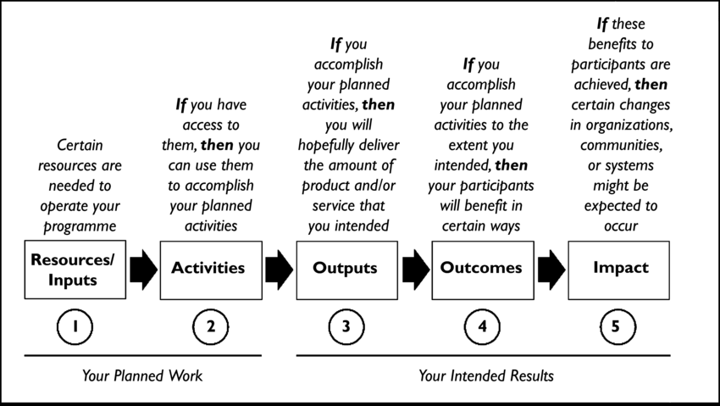
Logic model

Slide 5
Project effectiveness model
Problem
Need
Performance Indicators
Goal
Activities
Objectives

Slide 6
Project effectiveness model
Problem
Need
Analysis
Interpretation
Performance Indicators
Goal
Activities
Objectives

Slide 7
Grant application format

Slide 8
Project effectiveness model
Problem
Need

Slide 9
Problem statement
WHAT THE PROJECT IS SEEKING TO ADDRESS AND WHAT HAS BEEN ATTEMPTED TO ADDRESS IT IN THE PAST.
This is a short story of the reason you need grant funds
Statement with statistics to show the need
What are the barriers – social, geographic, economic, language, etc.
Who, how much, and what for should be addressed
Conclude with how the project will address the needs

Slide 10
Mock application
ALOHA POLICE DEPARTMENT

Slide 11
Project effectiveness model Worksheet
Problem or
Need Statement
Statement: ____________________________________________________
_____________________________________________________________
_____________________________________________________________

Slide 12

Project effectiveness model
Problem
Need
Goal

Slide 13
GOAL
GENERAL STATEMENT OF OVERALL PURPOSE OF THE PROJECT.
What you want to achieve through addressing the problem
Realistic: can be done within timeframe and resources available
Non specific and not usually measurable – broad statement on how you will achieve/solution to the problem statement

Slide 14
goal examples
POOR GOALS | GOOD GOALS
I want to get fit. | To lose weight before my brother’s wedding.
World Peace. | To see an increase in people participating in community service.
I want a new car. | To buy my dream car for Christmas.
No more car break-ins. | To reduce the number of cars broken into in Beat 6.

Slide 15
goal examples
To improve the quality of the department’s investigations into reports of sexual assaults against juveniles and adults.
To ensure the forensic laboratory follows the National accreditation policy and procedures.
To reduce gun crime and gang violence by employing a research-driven approach to reducing firearm crimes by implementing a NIBIN Program in the state.
To increase the capacity and efficiency of our agency in providing services to clients.

Slide 16
Project effectiveness model Worksheet
Goal
Goal: ________________________________________________________
_____________________________________________________________
_____________________________________________________________

Slide 17
Project effectiveness model
Problem
Need
Goal
Objectives

Slide 18
OBJECTIVE
SPECIFIC STATEMENT OF MEASURABLE RESULTS TO BE ACHIEVED WITHIN A STATED PERIOD OF TIME.
SMART – Specific, Measureable, Achievable, Realistic, Time-sensitive
Clearly stated so that project can be evaluated by outcomes

Slide 19
Objective examples
POOR OBJECTIVES | GOOD OBJECTIVES
Create a website that is appealing for all age groups. | Educate and create behavior change in 2,000 12-18 year olds on ways to reduce bullying in schools within the first 3 months by reducing the number of bullying complaints.
Expansion of partnerships and networks. | Develop partnerships with 20 local agencies to reduce the number of complaints by 20% at the end of the first year.
Raise awareness of the issue of mental health. | To raise awareness on the issue of youth suicide by providing 12 Mental Health First Aid classes to each teacher and support staff in the school on how to identify someone contemplating suicide by the 6th month.

Slide 20
Objective examples
To improve the quality of the department’s investigations into reports of sexual assaults against juveniles and adults
Of the 300 current cases, the Prosecutor’s Office will improve the rate of prosecutable sexual assault investigations by 10% at the end of the project period.
To ensure the forensic laboratory follows the National accreditation policy and procedures.
All criminalists will be certified by the American Society of Forensic Laboratories in one year.
To reduce gun crime and gang violence by employing a research-driven approach to reducing firearm crimes by implementing a NIBIN Program in the state.
Test and enter all new seized firearms into NIBIN within 10 days.
To increase the capacity and efficiency of our agency in providing services to clients.
Community Service Agency will hire a Care Coordinator to provide case management in 1 month from contract start date.
20

Slide 21
Project effectiveness model Worksheet
Goal
Objective
Objective
Objective #1: ____________________
_______________________________
_______________________________
Objective #2: ____________________
_______________________________
_______________________________

Slide 22
Project effectiveness model
Problem
Need
Activities
Goal
Objectives

Slide 23
Project Activities
A DETAILED DESCRIPTION OF SPECIFIC ACTIONS THAT ARE EXPECTED TO PRODUCE RESULTS WHICH MEET THE STATED GOALS AND OBJECTIVES.
Timeline of when activities will be implemented
Resources to be available

Slide 24
activity examples
To improve the quality of the department’s investigations into reports of sexual assaults against juveniles and adults
Of the 300 current cases, the Prosecutor’s Office will improve the rate of prosecutable sexual assault investigations by 10% at the end of the project period.
In October, the Prosecutor’s Office will attend training on new investigation techniques of sexual assault cases at the National Conference in Seattle.
To increase the capacity and efficiency of our agency in providing services to clients.
Community Service Agency will hire a Care Coordinator to provide case management in 1 month from contract start date.
Community Service Agency will complete a case plan with all newly referred clients at the first case management appointment.
24
Notes:
24

Slide 25
Project effectiveness model Worksheet
Goal
Objective
Objective
Activities
Activities
Activity: ________________________
_______________________________
_______________________________
Activity: ________________________
_______________________________
_______________________________

Slide 26
Project effectiveness model
Problem
Need
Performance Indicators
Goal
Activities
Objectives

Slide 27
PERFORMANCE INDICATOR
EXPLICIT MEASURE OF OUTPUTS/OUTCOMES THAT ARE EXPECTED FROM THE PERFORMANCE OF ACTIVITIES.
How you will measure your objectives
Include data/numbers to achieve
Use baseline data for comparison
Identify how you will you collect the data
Output versus Outcomes

Slide 28
PERFORMANCE INDICATOR examples
To improve the quality of the department’s investigations into reports of sexual assaults against juveniles and adults
Of the 300 current cases, the Prosecutor’s Office will improve the rate of prosecutable sexual assault investigations by 10% at the end of the project period.
In October, the Prosecutor’s Office will attend training on new investigation techniques of sexual assault cases at the National Conference in Seattle.
        # of prosecutors attending the National Conference
        # of cases brought to prosecution compared to last years number of 130 cases
        % of successful convictions from sexual assault investigations each month
28

Slide 29
PERFORMANCE INDICATOR examples
To increase the capacity and efficiency of our agency in providing services to clients.
Community Service Agency will hire a Care Coordinator to provide case management in 1 month from contract start date.
Community Service Agency will complete a case plan with all newly referred clients at the first case management appointment.
        # of case plans completed monthly
        Date the Care Coordinator was hired
        % of clients reporting a positive case management experience on the client satisfaction survey.
29
Notes:
29

Slide 30
Measures: Output versus outcome
OUTPUTS | OUTCOMES
# of criminalists achieving certification # of certified criminalists at the end of the project | % of criminalists satisfied with their training program the Aloha Police Department based on the annual satisfaction survey.
# of seized firearms # seized firearms entered into NIBIN | % of citizens that report a reduction in gang violence in their area based on a community impact survey.
30

Slide 31
Project effectiveness model Worksheet
Goal
Activities
Objective
Objective
Activities
Performance Indicator
Performance Indicator
Indicator: _______________________
_______________________________
_______________________________
Indicator: _______________________
_______________________________
_______________________________
Notes:
31

Slide 32
Project effectiveness model
Problem
Need
Analysis
Interpretation
Performance Indicators
Goal
Activities
Objectives
Notes:
32

Slide 33
sustainability
HOW THE PROJECT WILL CONTINUE AFTER GRANT FUNDING IS EXHAUSTED.
How will the project continue after this grant is completed
What plans are set to sustain the funding needed for the project

Slide 34
BUDGET DETAIL
DETAILED COST OUTLINE FOR SPECIFIC BUDGET CATEGORIES
All cost items must be directly associated with the project activities and contribute towards the achievement of the goals and objectives.

Slide 35
Budget detail
Salaries and Wages
Fringe Benefits
Contracts and Consultants
Travel and Subsistence
Office Supplies
Equipment
Other Costs
Indirect Costs

Slide 36
BUDGET EXPLANATION
COMPREHENSIVE EXPLANATION FOR EACH COST CATEGORY
ITEM IN THE BUDGET DETAIL.
Show how the individual costs in the detail are necessary to the project.

Slide 37
BUDGET example
Aloha Police Department Mock Application

Slide 38
DO | DO NOT
Make sure the goals, objectives and activities are linked so you can measures how the project is working | Start project writing until you have done research on what has been done and what will be available as resources for the project
Make sure your objectives are SMART | Determine your activities first and then figure out why/how you want to have agency implement them
Have someone outside of project review the application to see if he/she is able to understand project | Write an application assuming the reader understands your project
Write your application as though the person reading it has no idea what the project is about | Use acronyms unless you are sure the person reading the application will understand it
Ensure the grant is a good fit for your agency and you have the capacity to complete the project and fulfill all requirements | Forget that a successful application is only the first step

Slide 39
DO | DO NOT
Use an active voice | Use vague phrases: we offer many services
Use words of statement: We will seize 40 grams of methamphetamine | Use passive words: We would like to prosecute 30 cases in one year
Make sure your sited sources are noted | Give random information without a worthy source attached
Double check the application instructions/RFP with your application proposal | Forget any attachments or certifications needed
Have a copy of the evaluation criteria while you are writing each section of the proposal | Forget to answer the question or provide the information requested in each section, even if you have already provided the information in a different section.
Develop a budget after objectives and activities have been solidified | Write your application proposal off a budget wish list

Slide 40
RESOURCES
BJA Grant Writing and Management Academy
www.bja.gov/gwma/index.html
DOJ Grants Financial Guide
https://ojp.gov/financialguide/DOJ/index.htm
Crime Prevention and Justice Assistance Division – Grants and Planning Branch
http://ag.hawaii.gov/cpja/gp/

Slide 41
CONTACT US
Grants and Planning Branch
Branch Chiefs
Calleen Ching Calleen.J.Ching@hawaii.gov
Shaleigh Tice Shaleigh.K.Tice@hawaii.gov
Criminal Justice Planning Specialists
Dawn Martin Dawn.M.Martin@hawaii.gov
Jennifer Cullen Jennifer.M.Cullen@hawaii.gov
Randi Barretto Randi.U.Barretto@hawaii.gov
Rima Spight Rima.A.Spight@hawaii.gov

