Slide 1
Unsheltered Youth: Moving Our Most Vulnerable Beyond the Risks of Exploitation
Carla Houser, MSW
Executive Director
RYSE
Notes:
---

Slide 2

We work in a continuum of support that empowers Hawaii's youth to move beyond Homelessness

Slide 3
Understanding Unsheltered Youth
Notes:
Root Causes of Youth Homelessness

Slide 4
Root Causes of Youth Homelessness
Family Conflict and Rejection
  Family issues like abuse, neglect, and rejection due to sexual orientation are primary causes of youth homelessness.
Economic Hardship
  Poverty and financial instability can force families into displacement, increasing youth homelessness risk.
Child Welfare and Justice System Gaps
  Youth aging out of foster care or juvenile justice systems often lack support, leading to homelessness.
Structural Inequities
  Limited affordable housing and scarce mental health services worsen youth homelessness.
Notes:
---
Youth homelessness often stems from a complex interplay of systemic and personal factors. Family conflict is one of the most common causes, frequently involving issues such as abuse, neglect, or rejection due to sexual orientation or gender identity. Economic hardship also plays a significant role, as families living in poverty may struggle to provide stable housing, leading to displacement. Additionally, involvement in the child welfare or juvenile justice systems can create gaps in support when youth age out of care without adequate transition planning. These root causes are compounded by structural inequities, including lack of affordable housing and limited access to mental health services. For example, studies show that LGBTQ+ youth are disproportionately represented among homeless populations, often due to familial rejection. Similarly, youth exiting foster care without permanent connections face heightened vulnerability. Understanding these underlying factors is critical for designing effective interventions that address not only immediate needs but also long-term stability. Programs that integrate family mediation, economic support, and systemic reforms can help reduce the incidence of youth homelessness and mitigate its associated risks.
Image source: Microsoft 365 content library

Slide 5

Homeless Youth: Who are they and how can we better serve them?
  78% unemployment
  60% CWS involvement
  45% no high school diploma
  51% Native Hawaiian
  45% little or no parental involvement
  47% have a diagnosed disability
  73% survivors of violence
  1st homeless experience at 14 yrs old

Slide 6
Intervention Strategies
Notes:
Low-Barrier Street Outreach Programs, Building Trust and Relationships

Slide 7

The 5 Skills:
Core Competencies for Educators and Youth Workers
RESPECT
HOW We Do The Work
WHAT We Say
Respond, Don't React
Embrace the "FAIL"

Slide 8

Low-Barrier Street Outreach Programs
Accessibility and Low Barriers
  Programs minimize eligibility requirements and offer services without judgment or complex processes to maximize outreach.
Trauma-Informed Care
  Approaches acknowledge past trauma and ensure interactions avoid re-traumatization, fostering trust and safety.
Mobile and Peer Outreach
  Mobile units and peer workers extend the program’s reach beyond fixed locations for greater community impact.
Comprehensive Care Entry Points
  Programs connect youth to mental health, substance use treatment, and education, supporting long-term stability.
Notes:
---
Low-barrier street outreach programs are a cornerstone of effective engagement with unsheltered youth. These initiatives prioritize accessibility by minimizing eligibility requirements and offering services without judgment or bureaucratic hurdles. Outreach teams often include trained professionals who provide immediate resources such as food, hygiene supplies, and emergency shelter referrals. Trauma-informed approaches are critical, ensuring that interactions acknowledge past experiences and avoid re-traumatization. For example, programs like Safe Place and Covenant House have demonstrated success by meeting youth where they are—physically and emotionally—and building trust through consistent, compassionate support. Mobile units and peer outreach workers further enhance reach, allowing services to extend beyond traditional facilities. These programs also serve as entry points to comprehensive care, including mental health counseling, substance use treatment, and educational support. By reducing barriers and fostering trust, street outreach creates a foundation for long-term engagement, helping youth transition from crisis to stability while addressing their unique needs in a respectful and empowering manner.
Image source: Microsoft 365 content library

Slide 9
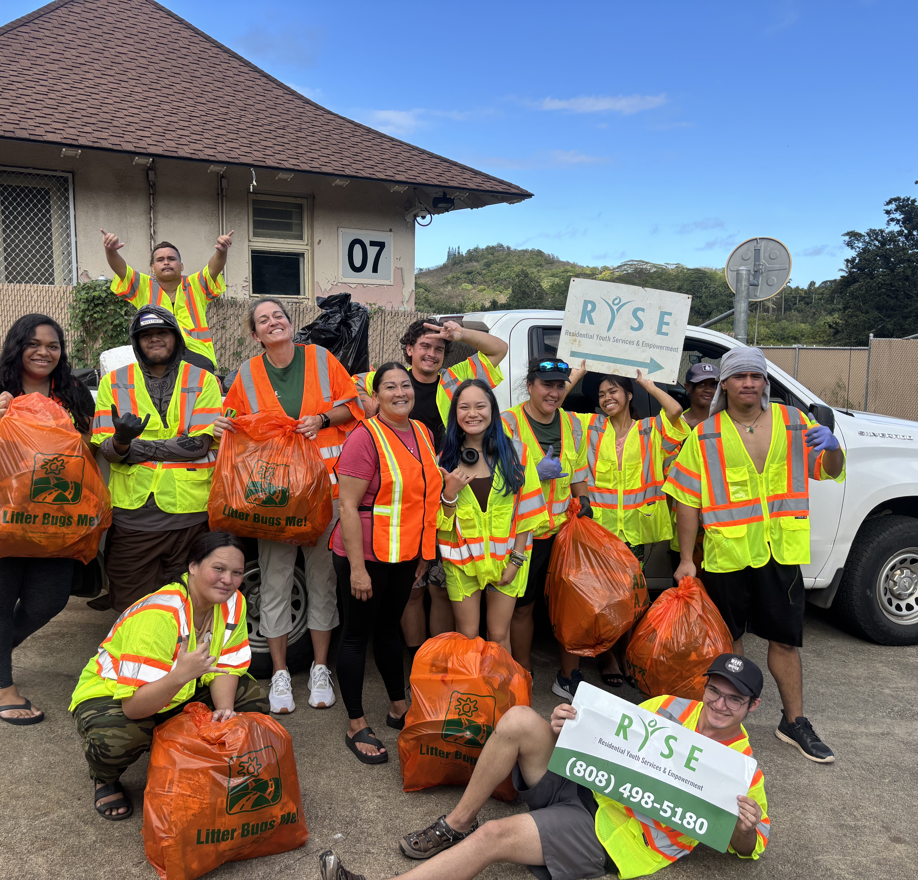
Building Trust and Relationships
Importance of Trust
  Trust is crucial for effective support with unsheltered youth who often face past betrayals and neglect.
Communication Strategies
  Non-judgmental communication and consistency help overcome barriers and build reliable relationships.
Peer Mentorship
  Peer mentors with lived experience offer relatable support, increasing youth engagement and trust.
Cultural Competence
  Culturally competent services respect diverse backgrounds, fostering inclusion and understanding.
Notes:
---
Establishing trust is essential for successful intervention with unsheltered youth. Many have experienced betrayal or neglect from adults and institutions, making them wary of authority figures. Non-judgmental communication and consistency are key strategies for overcoming this barrier. Outreach workers must demonstrate reliability by following through on promises and respecting youth autonomy. Active listening and empathy help create a sense of safety, encouraging youth to share their needs and goals. For instance, programs that employ peer mentors—individuals with lived experience of homelessness—often achieve higher engagement rates because they offer relatable perspectives. Cultural competence is equally important, ensuring that services honor diverse backgrounds and identities. Building trust is not a one-time effort but an ongoing process that requires patience and adaptability. When youth feel valued and understood, they are more likely to participate in programs that promote stability, such as housing initiatives and educational opportunities. Ultimately, trust forms the foundation for all other interventions, enabling sustainable progress toward independence and well-being.
Image source: Microsoft 365 content library

Slide 10
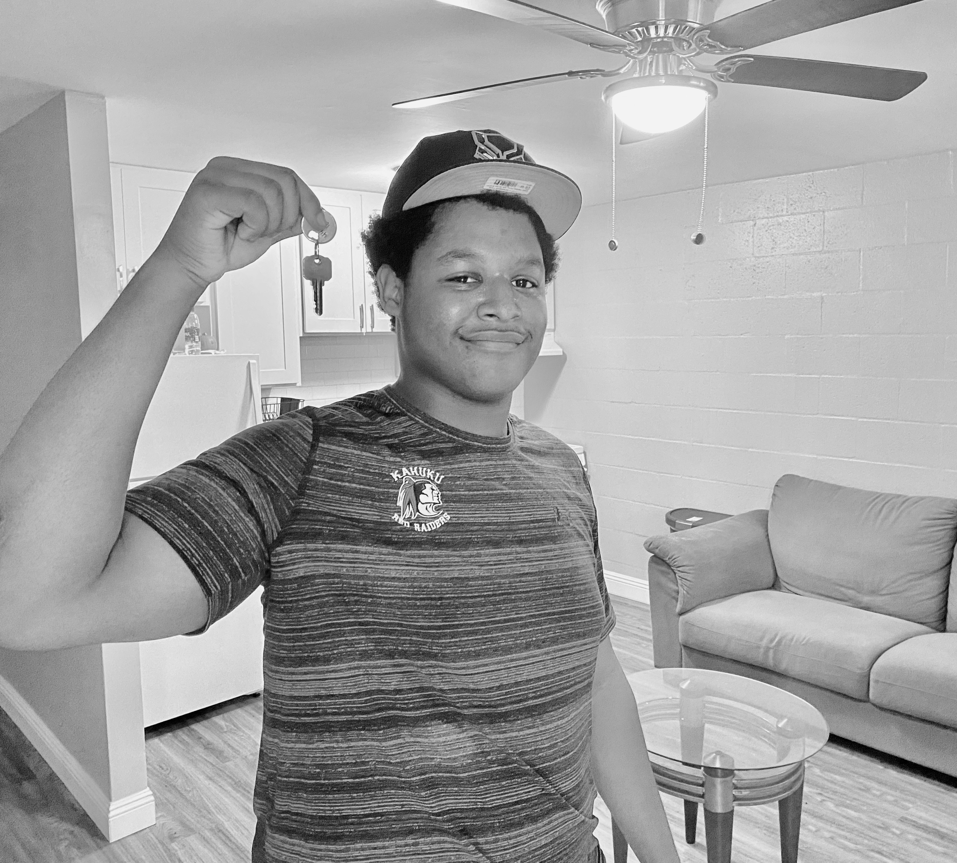
Pathways to Stability
THE vision: no homeless youth in Hawaii.
"Functional Zero"
Notes:
Comprehensive Support for Long-Term Success

Slide 11
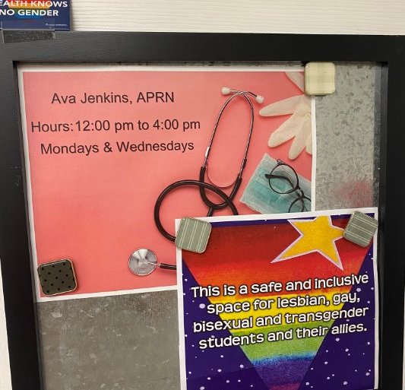
Comprehensive Support for Long-Term Success
Safe Housing Solutions
  Programs like rapid rehousing and transitional living provide safe environments for youth progressing toward independence.
Healthcare Access
  Access to physical, mental, and behavioral health services helps mitigate trauma and chronic stress among youth.
Education and Vocational Training
  Education and vocational programs create pathways to economic security and sustainable careers for youth.
Advocacy and Mentorship
  Advocacy connects youth to resources and protections, while mentorship and financial literacy support adulthood skills.
Notes:
---
Achieving stability for unsheltered youth requires a holistic approach that addresses multiple dimensions of well-being. Housing is the most immediate need, with programs like rapid rehousing and transitional living offering safe environments while youth work toward independence. Healthcare access is equally critical, encompassing physical, mental, and behavioral health services to mitigate the effects of trauma and chronic stress. Education and vocational training provide pathways to economic security, enabling youth to build sustainable careers. Advocacy plays a vital role in connecting youth to benefits, legal protections, and community resources. For example, integrated service models such as those used by Youth Villages combine housing, counseling, and life skills training under one umbrella, ensuring continuity of care. Financial literacy programs and mentorship further support long-term success by equipping youth with practical tools for managing adulthood. By addressing housing, health, education, and advocacy in tandem, these comprehensive strategies empower youth to break cycles of homelessness and exploitation, fostering resilience and self-sufficiency.
Image source: Microsoft 365 content library

Slide 12



Empowerment
ADVOCACY
"With us, not for us."
EDUCATION
  Partnerships with local HS, community colleges and vocational programs including on site GED classes
  Financial literacy, independent living skills training
  Cultural connectedness
EMPLOYMENT
  Paid internships
  Pathways to living wage jobs!!

Slide 13

MAHALO!
808.498.5180
info@rysehawaii.org
www.rysehawaii.org

